Slide 1
Classroom slides – memory systems

Slide 2
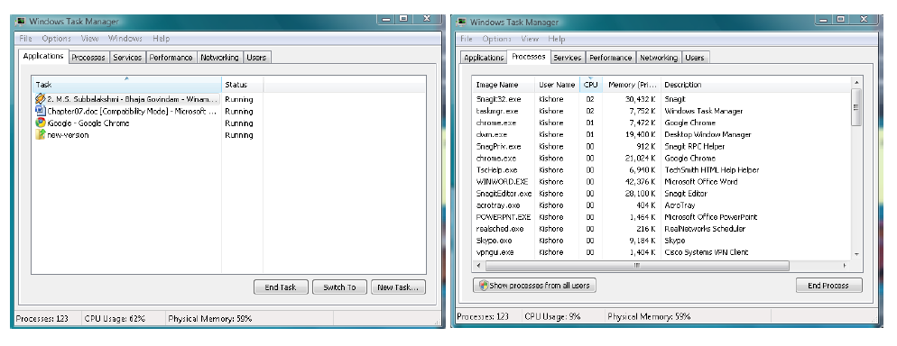

Slide 3
B
R
O
K
E
R
CPU
Memory
CPU generated
Address
Memory
Address

Slide 4
Fence register
Memory
Kernel
Low
Y
CPU
>
User
CPU generated
Address
N
Memory
Address
High
Trap

Slide 5
Memory
Low
Kernel
Lower bound
Upper bound
P1
.
.
.
.
Y
Y
CPU
>
<
CPU
Address
N
N
Memory
Address
Trap
Trap
P2
Pn
High

Slide 6
PCB
enum state_type {new, ready, running, waiting, halted};
typedef struct control_block_type {
enum state_type state;
address PC;
int reg_file[NUMREGS];
struct control_block *next_pcb;
int priority;
address memory_footprint; ????
….
….
} control_block;

Slide 7
Memory
Low
Kernel
Base
Limit
P1
.
.
.
.
Y
CPU
+
<
CPU
Address
N
Memory
Address
Trap
P2
Pn
High

Slide 8
PCB
enum state_type {new, ready, running, waiting, halted};
typedef struct control_block_type {
enum state_type state;
address PC;
int reg_file[NUMREGS];
struct control_block *next_pcb;
int priority;
address memory_footprint; ????
….
….
} control_block;

Slide 9
Fixed size partitions
memory
Allocation table
5K
Occupied bit
Partition Size
Process
0
5K
XXX
8K
0
8K
XXX

Slide 10
Memory
Allocation table
5K
Occupied bit
Partition Size
Process
0
5K
XXX
6K
1
8K
P1
2K

Slide 11
Variable size partitions
memory
Allocation table
Start address
Size
Process
0
13K
FREE
13K

Slide 12
Memory
Allocation table
Start address
Size
Process
11K
0
2K
P1
2K
6K
P2
2K
8K
3K
P3
11K
2K
FREE

Slide 13
Memory
Allocation table
2K
Start address
Size
Process
9K
0
2K
FREE
2K
6K
P2
2K
8K
3K
P3
11K
2K
FREE
New request:
P4 needs 4K
Possible?

Slide 14
Memory
Allocation table
2K
Start address
Size
Process
9K
0
2K
FREE
2K
6K
P2 -> FREE
2K
8K
3K
P3
11K
2K
FREE

Slide 15
Memory
Allocation table
Start address
Size
Process
8K
0
8K
FREE
3K
8K
3K
P3
2K
11K
2K
FREE

Slide 16
Compaction
Memory
Allocation table
3K
Start address
Size
Process
0
3K
P3
10K
3K
10K
FREE

Slide 17
Paging and virtual memory
B
R
O
K
E
R
CPU
Memory
Virtual
Address
Page
Table
Physical
Address

Slide 18
Physical
Memory
LOW
12
Page Table
User’s view
Page 0
35
15
Page 1
52
Page 2
12
Page 3
15
35
52
HIGH

Slide 19
Address translation
Virtual
Address
Physical
Address
CPU
VPN
Page offset
PPN
Page offset
Memory
PPN
Page table

Slide 20
Example 3:
Consider a memory system with a 32-bit virtual address. Let us assume the pagesize is 8K Bytes.
Example 4:
Consider a memory system with 32-bit virtual addresses and 24-bit physical memory addresses. Assume that the pagesize is 4K Bytes. Show the layout of the virtual and physical addresses. How big is the page table? How many page frames are there in this memory system?

Slide 21
Physical Memory
Low
Memory
manager
PT_{Pn}
Kernel
Space
…
PT_{P2}
PT_{P1}
User
Space
High

Slide 22
PCB
enum state_type {new, ready, running, waiting, halted};
typedef struct control_block_type {
enum state_type state;
address PC;
int reg_file[NUMREGS];
struct control_block *next_pcb;
int priority;
address PTBR;
….
….
} control_block;

Slide 23
Paged memory allocation
Allocate all at once at load time?
Allocate on demand?

Slide 24
Demand paging
Valid
PFN
PTE

Slide 25
I₅
I₄
I₃
I₂
I₁
B
U
F
F
E
R
B
U
F
F
E
R
B
U
F
F
E
R
B
U
F
F
E
R
IF
ID/RR
EX
MEM
RW
Instruction
in
Instruction
out
Potential page faults

Slide 26
Freelist
freelist
Pframe 52
Pframe 20
Pframe 200
…
Pframe 8

Slide 27
Frame Table
0
<P2, 20>
1
free
2
<P5, 15>
Pframe
3
<P1, 32>
<PID, VPN>
4
free
5
<P3, 0>
6
<P4, 0>
7
free

Slide 28
Disk Map
Disk map for P1
0
disk address
1
disk address
disk address
P₁
P₂
…..
p_{n}
2
VPN
3
disk address
4
disk address
disk address
Swap space
5
6
disk address
7
disk address

Slide 29
Example
  process P1 page fault at VPN = 20.
  free-list is empty.
  selects page frame PFN = 52 as the victim.
  frame currently houses VPN = 33 of process P4.

Slide 30
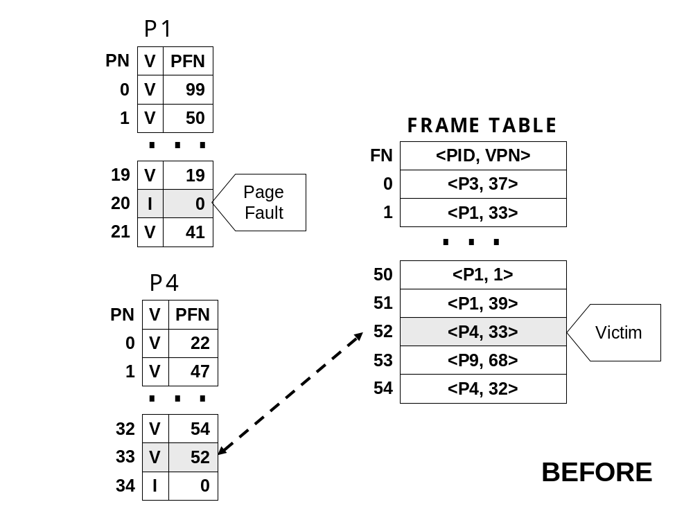

Slide 31
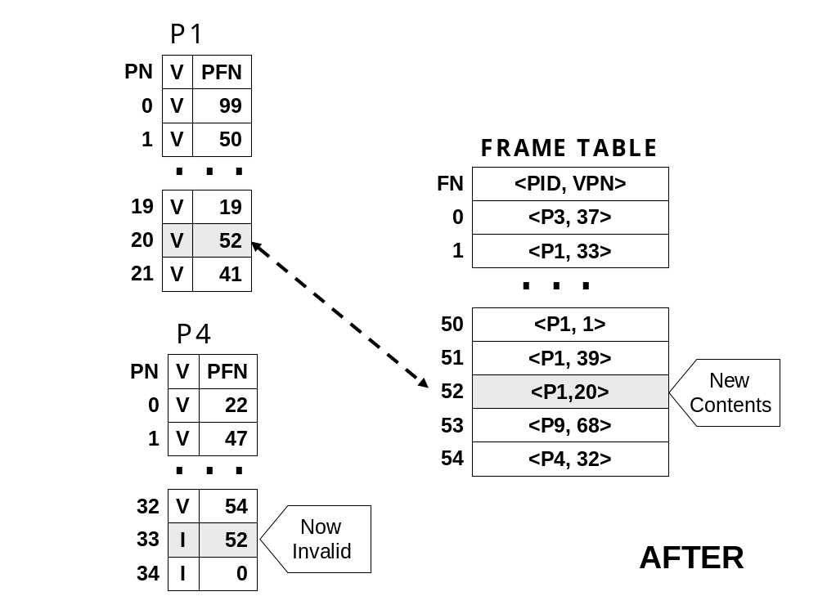

Slide 32
User level
Program 1
Program 2
……….
Program n
Kernel
PT₁
DM₁
PT₂
DM₂
.
.
.
.
FT
ready_q
freelist
PCB₁
PCB₂
…
Pframe
Pframe
…
CPU scheduler
Memory Manager
Hardware
Process dispatch
CPU
Timer interrupt
Page fault

Slide 33
FIFO Page Replacement
Circular queue
Head
<PID, VPN>
<PID, VPN>
Full
…..
<PID, VPN>
Tail
free

Slide 34
Consider a string of page references by a process:
Reference number: 1 2 3 4 5 6 7 8 9 10 11 12 13
----------------------------------------------------------
Virtual page number: 9 0 3 4 0 5 0 6 4 5 0 5 4
Assume there are 3 physical frames.
Circular queue
Head
free
free
Full = false
free
Tail

Slide 35
Reference #1 (PF)
Reference #2 (PF)
Head
9
Head
9
Full = false
free
0
Full = false
free
free
Tail
Tail
Reference #3 (PF)
Reference #4 (PF)
Head
9
Head
4
Full = true
0
0
Full = true
3
3
Tail
Tail
Reference #5 (HIT)
Reference #6 (PF)
Head
4
Head
4
Full = true
0
Full = true
5
3
3
Tail
Tail

Slide 36
Consider a string of page references by a process:
Reference number: 1 2 3 4 5 6 7 8 9 10 11 12 13
----------------------------------------------------------
Virtual page number: 9 0 3 4 0 5 0 6 4 5 0 5 4

Slide 37
Belady’s Min
Consider a string of page references by a process:
Reference number: 1 2 3 4 5 6 7 8 9 10 11 12 13
----------------------------------------------------------
Virtual page number: 9 0 3 4 0 5 0 6 4 5 0 5 4

Slide 38
LRU
Push down stack
top
<PID, VPN>
<PID, VPN>
…..
<PID, VPN>
bottom
free

Slide 39
Consider a string of page references by a process:
Reference number: 1 2 3 4 5 6 7 8 9 10 11 12 13
----------------------------------------------------------
Virtual page number: 9 0 3 4 0 5 0 6 4 5 0 5 4
Assume there are 3 physical frames.
stack
top
free
free
bottom
free

Slide 40
Reference #1 (PF)
Reference #2 (PF)
Top
9
Top
0
free
9
Bottom
free
Bottom
free
Reference #3 (PF)
Reference #4 (PF)
Top
3
Top
4
0
3
Bottom
9
Bottom
0
Reference #5 (HIT)
Reference #6 (PF)
Top
0
Top
5
4
0
Bottom
3
Bottom
4

Slide 41
Approximate LRU
Small hardware stack
Reference bit per physical frame

Slide 42
Approximate LRU with ref bits
31
0
0/1
Counter for Page frame 0
Per page
Frame
Reference
bits
0/1
Counter for Page frame 1
0/1
…………
0/1
Counter for Page frame n
Keep ref bits in PT
  Set bit when page referenced
Paging daemon
  Flush ref bits to software counters
  Clear ref bits
Victim?

Slide 43
Reference
bit
Page #
Second chance replacement
or
Clock algorithm
1
10
1
1
1
5
FIFO candidate
1
7
Pointer
1
8
0
3
0
4
FIFO order
1
9

Slide 44
Reference
bit
Page #
1
10
1
6
1
1
1
2
1
5
FIFO candidate
Pointer
1
9
1
7
0
4
1
8
FIFO order
0
3

Slide 45
Reference
bit
Page #
1
10
1
6
1
1
1
2
1
5
Pointer
1
9
0
7
Actual victim
0
4
0
8
FIFO order
0
3

Slide 46
Reference
bit
Page #
1
10
1
1
1
5
Actual victim
0
7
Pointer
0
8
0
3
0
4
FIFO order
1
9

Slide 47
ALGORITHM | HARDWARE ASSIST | COMMENTS
FIFO | None | Could lead to anomalous behavior
Belay’s MIN | Oracle | Provably optimal; not realizable in hardware; useful as a standard
True LRU | Push down stack | Expected performance close to optimal; infeasible
Approximate LRU #1 | A small hardware stack | Expected performance close to optimal; worst-case performance may be similar to FIFO
Approximate LRU #2 | Reference bit per page | Expected performance close to optimal; moderate hardware complexity
Second chance replacement | Reference bit per page | Expected performance better than FIFO; memory manager implementation simplified compared to LRU schemes

Slide 48
Optimizations
Pool of free frames
  Overlap I/O with processing
victim
freelist
Dirty
Clean
Clean
Pframe 52
Pframe 22
Pframe 200
….

Slide 49
  Reverse mapping to PT
    Gives a “third” chance for reuse of a page before being kicked out
freelist
Dirty
Clean
Clean
Pframe 52
Pframe 22
Pframe 200
….
<PID, VPN>
<PID, VPN>
<PID, VPN>

Slide 50
CPU Utilization
Degree of multiprogramming

Slide 51
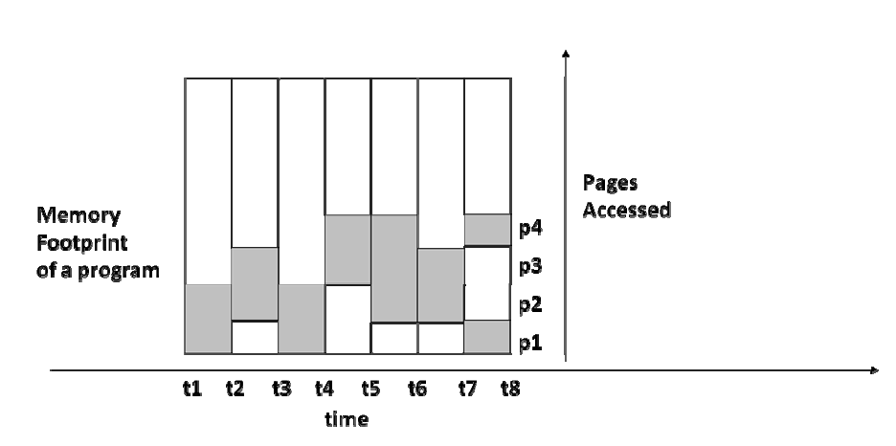

Slide 52
Page fault
rate
High water
mark
Low water
mark
# physical frames per process

Slide 53
Address translation
Virtual
Address
Physical
Address
CPU
VPN
Page offset
PPN
Page offset
Memory
PPN
Page table

Slide 54
TLB
USER/KERNEL | VPN | PFN | VALID/INVALID
U | 0 | 122 | V
U | XX | XX | I
U | 10 | 152 | V
U | 11 | 170 | V
K | 0 | 10 | V
K | 1 | 11 | V
K | 3 | 15 | V
K | XX | XX | I

Slide 55
TLB Hit
Virtual
Address
Physical
Address
CPU
VPN
Page offset
PPN
Page offset
Memory
TLB
Page
Table

Slide 56
TLB Miss
Virtual
Address
Physical
Address
CPU
VPN
Page offset
PPN
Page offset
Memory
TLB
Page
Table

Slide 57
VPN1
VPN2
10 bits
10 bits
2nd level
Page table
2nd level
Page table
1st level
Page table
PPN
.
.
.
.
.
.
2nd level
Page table

Slide 58
7.5 Segmented Virtual Memory
Segmentation is a system allowing a process's memory space to be subdivided into chunks of memory each associated with some aspect of the overall program
Typical segments
  Code
  Global data
  Heap
  Stack

Slide 59
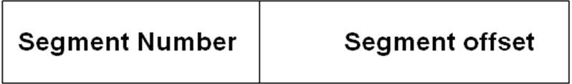
7.5 Segmented Virtual Memory
Process address space divided up into n distinct segments
Each segment has
  A number
  A size
Each segment starts at its own address 0 and goes up to its size – 1.
Segment addressing

Slide 60
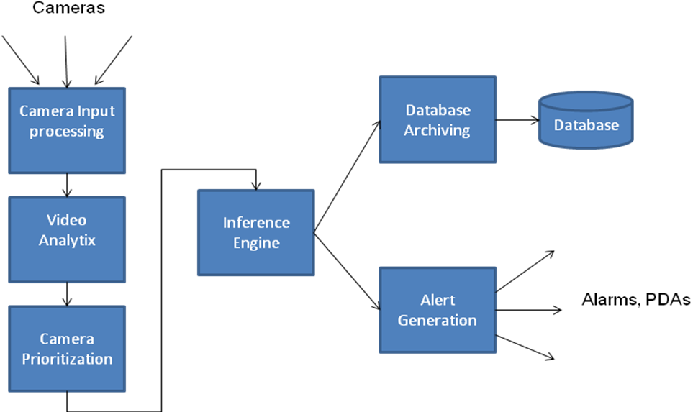
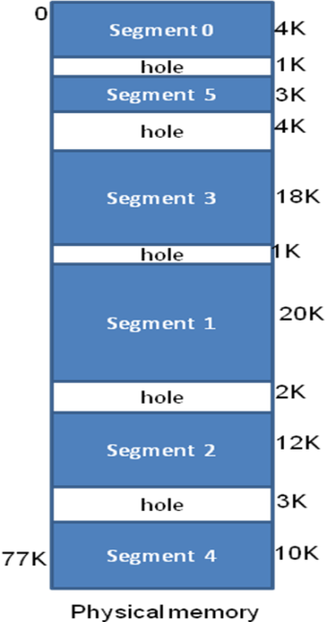
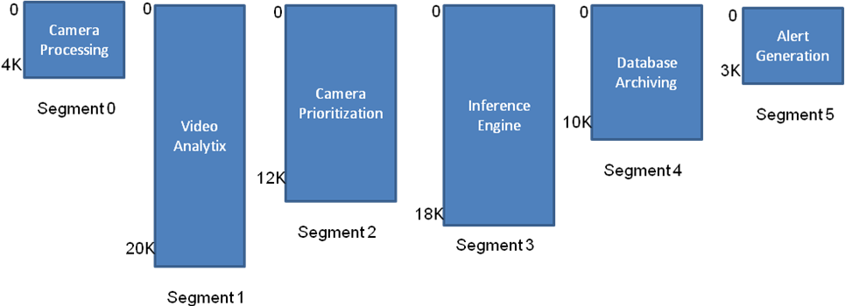
7.5 Segmented Virtual Memory

Slide 61
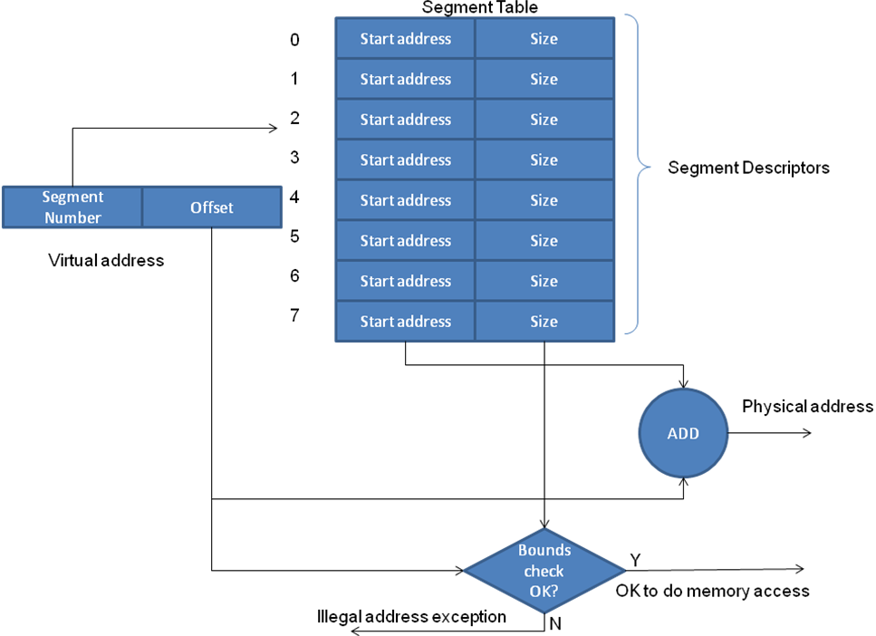
7.5.1 Hardware for Segmentation

Slide 62
7.6 Paging versus Segmentation
Attribute | Paging | Segmentation
User shielded from size limitation of physical memory | Yes | Yes
Relationship to physical memory | Physical memory may be less than or greater than virtual memory | Physical memory may be less than or greater than virtual memory
Address spaces per process | One | Several
Visibility to the user | User unaware of paging; user is given an illusion of a single linear address space | User aware of multiple address spaces each starting at address 0
Software engineering | No obvious benefit | Allows organization of the program components into individual segments at user discretion; enables modular design; increases maintainability
Program debugging | No obvious benefit | Aided by the modular design
Sharing and protection | User has no direct control; operating system can facilitate sharing and protection of pages across address spaces but this has no meaning from the user’s perspective | User has direct control of orchestrating the sharing and protection of individual segments; especially useful for object-oriented programming and development of large software
Size of page/segment | Fixed by the architecture | Variable chosen by the user for each individual segment
Internal fragmentation | Internal fragmentation possible for the portion of a page that is not used by the address space | None
External fragmentation | None | External fragmentation possible since the variable sized segments have to be allocated in the available physical memory thus creating holes (see Figure 7.18)

Slide 63
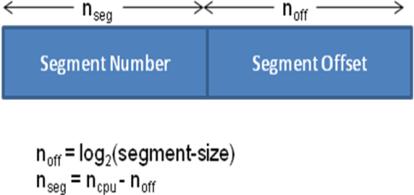
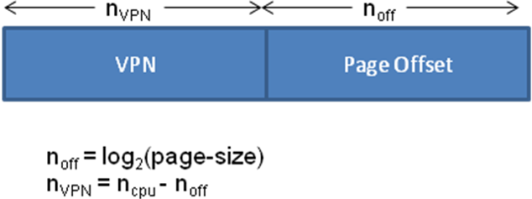
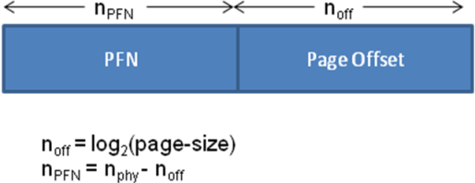
7.6.1 Interpreting the CPU generated address
Memory System | Virtual Address Computation | Physical Address Computation | Size of Tables
Segmentation |  | Segment Start address = Segment-Table [Segment-Number] Physical address = Segment Start Address + Segment Offset | Segment table size = 2^{nseg} entries
Paging |  | PFN = Page-Table[VPN] Physical address: | Page table size = 2^{nVPN} entries

Slide 64
7.7 Summary
Memory Management Criterion | User/ Kernel Separation | Fixed Partition | Variable-sized Partition | Paged Virtual Memory | Segmented Virtual Memory | Paged-segmented Virtual Memory
Improved resource utilization | No | Internal fragmentation bounded by partition size; External fragmentation | External fragmentation | Internal fragmentation bounded by page size | External fragmentation | Internal fragmentation bounded by page size
Independence and protection | No | Yes | Yes | Yes | Yes | Yes
Liberation from resource limitation | No | No | No | Yes | Yes | Yes
Sharing by concurrent processes | No | No | No | Yes | Yes | Yes
Facilitates good software engineering practice | No | No | No | No | Yes | Yes

Slide 65
7.7 Summary
Scheme | Hardware Support | Still in Use?
User/Kernel Separation | Fence register | No
Fixed Partition | Bounds registers | Not in any production operating system
Variable-sized Partition | Base and limit registers | Not in any production operating system
Paged Virtual Memory | Page table and page table base register | Yes, in most modern operating system
Segmented Virtual Memory | Segment table, and segment table base register | Segmentation in this pure form not supported in any commercially popular processors
Paged-segmented Virtual Memory | Combination of the hardware for paging and segmentation | Yes, most modern operating systems based on Intel x86 use this scheme¹
^{[1]} It should be noted that Intel’s segmentation is quite different from the pure form of segmentation presented in this chapter. Please Section 7.8.2 for a discussion of Intel’s paged-segmentation scheme.

Slide 66
7.8 Historical Perspective
Burroughs Corporation introduced segmented virtual memory in B5000 line of machines
GE, in partnership with MULTICS project at MIT introduced paged-segmentation in GE 600 line of machines
IBM introduces system/360 with base and limit registers. Relocation system not effective since base register visible to programmers
IBM introduces system/370 with true virtual memory which eventually dominates market

Slide 67
7.8.1 MULTICS
Some academic computing projects have a profound impact on evolution of field for a very long time.
MULTICS project at MIT was one such.
Unix, Linux, Paging, Segmentation, Security, Protection, etc. had their birth in this project.
OS concepts introduced in MULTICS project were way ahead of their time and processor architectures of that time were not geared to support advanced concepts of memory protection advocated by MULTICS.
MULTICS introduced the concept of paged segmentation.

Slide 68
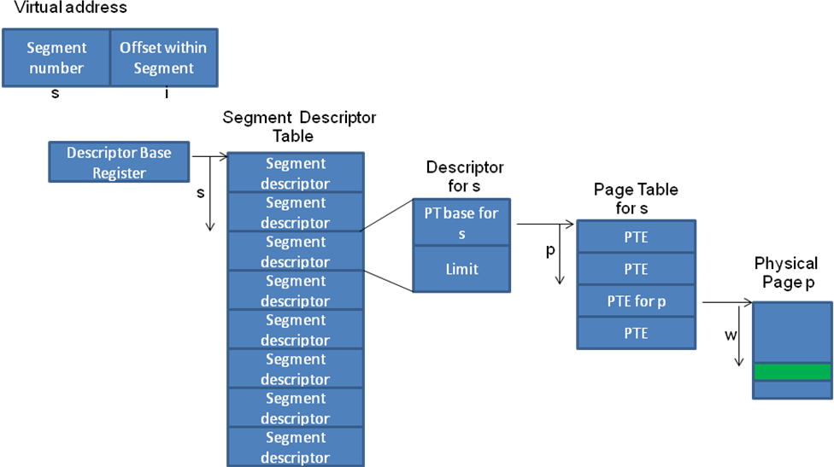
7.8.1 MULTICS

Slide 69
7.8.2 Intel’s Memory Architecture
Intel Pentium line of processors uses paged-segmentation.
Approximately, a virtual address is a segment selector plus an offset
Total segment space divided into two halves
  System segments are common to all processes and are used by OS
  User segments are unique to each process.
Two descriptor tables
  Global Descriptor Table (GDT) common to all processes
  Local Descriptor Table (LDT) for each process
A bit in the segment selector identifies whether the segment being named by the virtual address is a system or a user segment.
Segment descriptor for the selected segment contains the details for translating the offset specified in the virtual address to a physical address.
Choice
  Use simple segmentation w/o any paging (compatible with earlier processors)
  Use paged-segmentation.

Slide 70
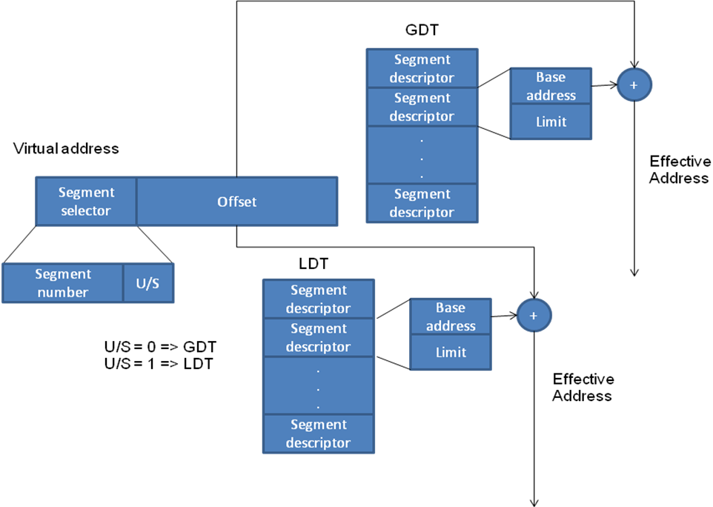
7.8.2 Intel’s Memory Architecture

